Slide 1
Find f(2)
Based on Perkins & Perkins Book 1 Page 39 Ex 3.1 Q10

Slide 2
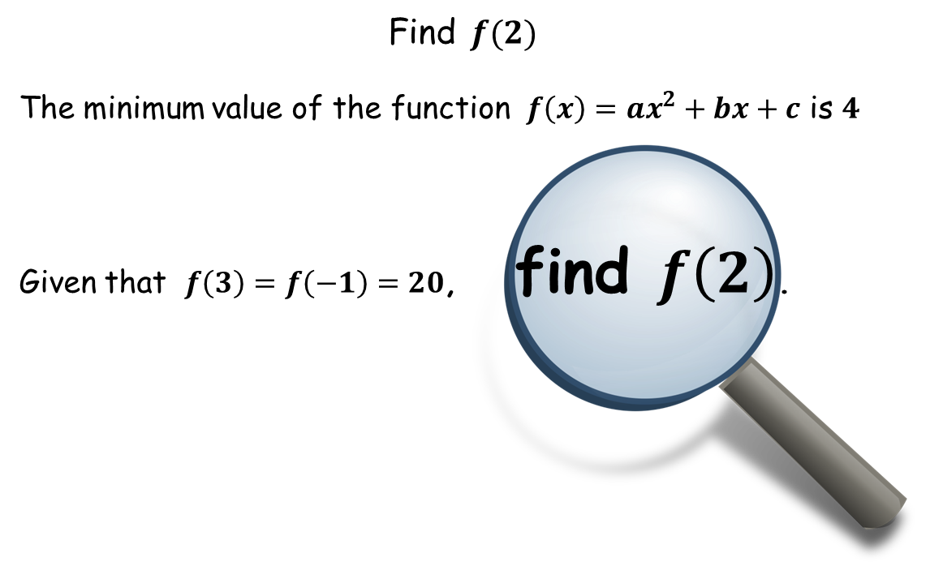

You will have one of these scenarios.
Start sketching and recall the properties of quadratics.

Slide 3


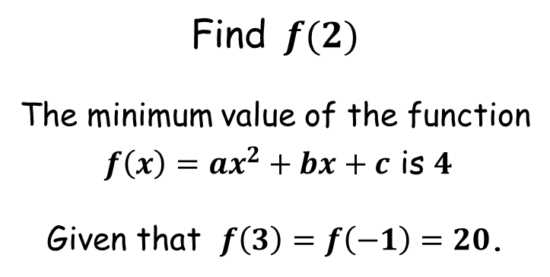



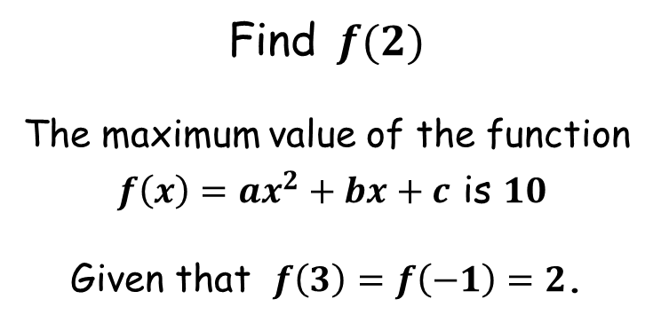









Find $f(2)$
The maximum value of the function
$f\left(x\right)=ax^{2}+bx+c$ is $10$
Given that $f\left(3\right)=f\left(−1\right)=2$.
Find $f(2)$
The minimum value of the function
$f\left(x\right)=ax^{2}+bx+c$ is $4$
Given that $f\left(3\right)=f\left(−1\right)=20$.
$$y$$
$$y$$
$$10$$
$$f\left(1\right)=10$$
$$20$$
$$2$$
$$4$$
$$f\left(1\right)=4$$
$$−1$$
$$1$$
$$3$$
$$x$$
$$−1$$
$$1$$
$$3$$
$$x$$
line of symmetry

Slide 4
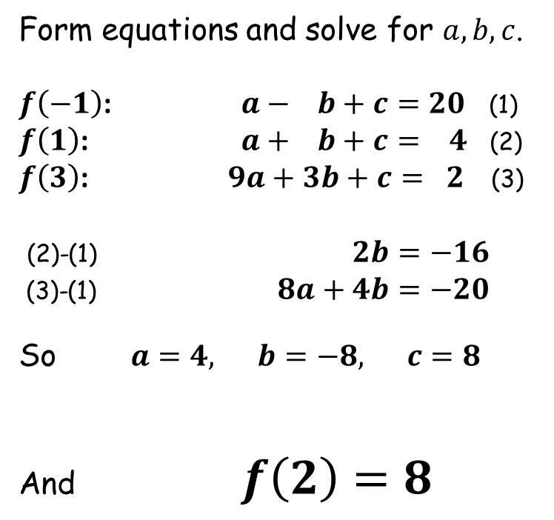
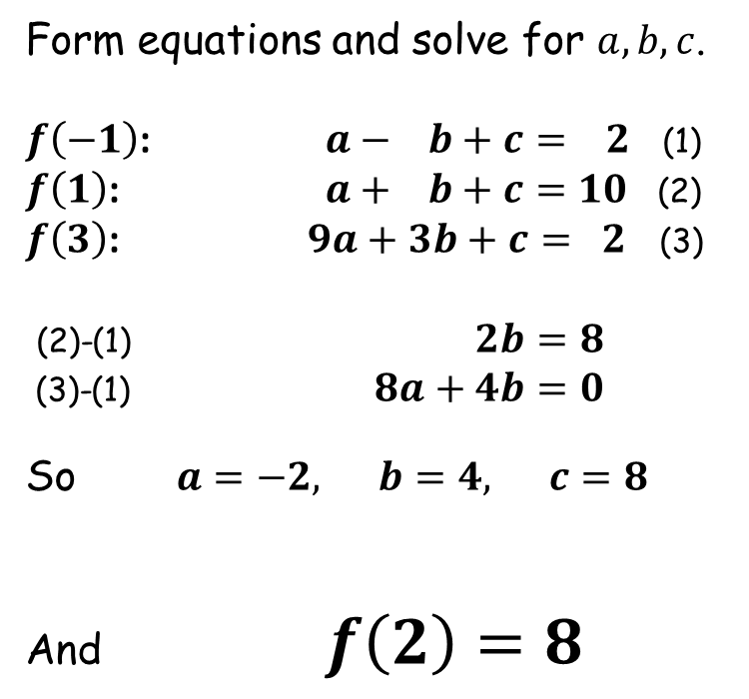
Find $f(2)$
The maximum value of the function
$f\left(x\right)=ax^{2}+bx+c$ is $10$
Given that $f\left(3\right)=f\left(−1\right)=2$.
Find $f(2)$
The minimum value of the function
$f\left(x\right)=ax^{2}+bx+c$ is $4$
Given that $f\left(3\right)=f\left(−1\right)=20$.
Form equations and solve for $a, b, c$.
$f\left(−1\right)$: $a− b+c= 2$ (1)
$f\left(1\right)$: $a+ b+c=10$ (2)
$f\left(3\right)$: $9a+3b+c= 2$ (3)
(2)-(1) $2b=8$
(3)-(1) $8a+4b=0$
So $a=−2, b=4, c=8$
And $f\left(2\right)=8$
Form equations and solve for $a, b, c$.
$f\left(−1\right)$: $a− b+c=20$ (1)
$f\left(1\right)$: $a+ b+c= 4$ (2)
$f\left(3\right)$: $9a+3b+c= 2$ (3)
(2)-(1) $2b=−16$
(3)-(1) $8a+4b=−20$
So $a=4, b=−8, c=8$
And $f\left(2\right)=8$

Slide 6
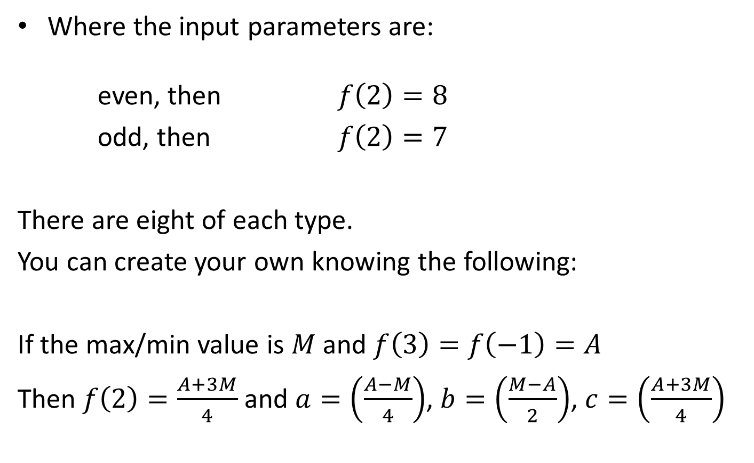
Note to Teacher
Where the input parameters are: even, then $f\left(2\right)=8$
odd, then $f\left(2\right)=7$
There are eight of each type.
You can create your own knowing the following:
If the max/min value is $M$ and $f\left(3\right)=f\left(−1\right)=A$
Then $f\left(2\right)=\frac{A+3M}{4}$ and $a=\left(\frac{A−M}{4}\right)$, $b=\left(\frac{M−A}{2}\right)$, $c=\left(\frac{A+3M}{4}\right)$

Slide 7
RESOURCES

Slide 9

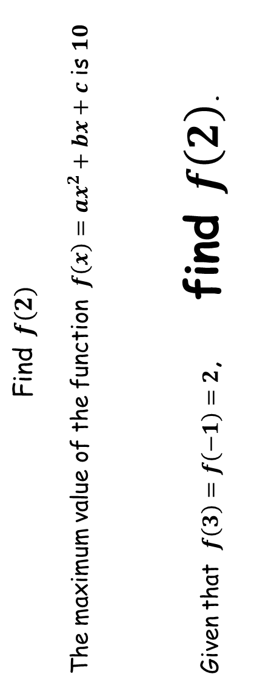
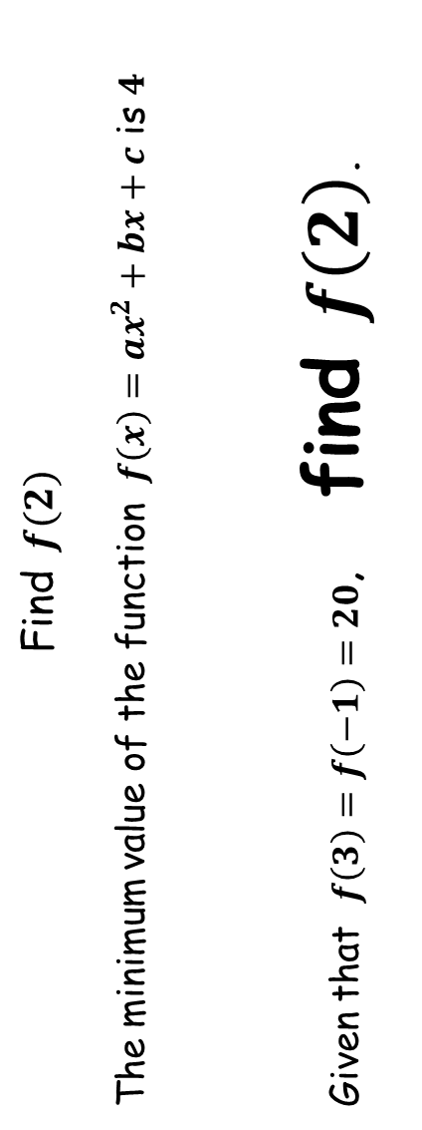
Find $f(2)$
The maximum value of the function $f\left(x\right)=ax^{2}+bx+c$ is $10$
Given that $f\left(3\right)=f\left(−1\right)=2$, find $f\left(2\right)$.
Find $f(2)$
The minimum value of the function $f\left(x\right)=ax^{2}+bx+c$ is $4$
Given that $f\left(3\right)=f\left(−1\right)=20$, find $f\left(2\right)$.
SIC_37
SIC_37

Slide 10
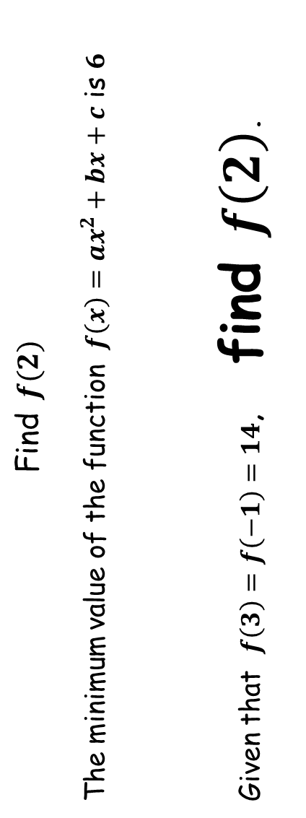
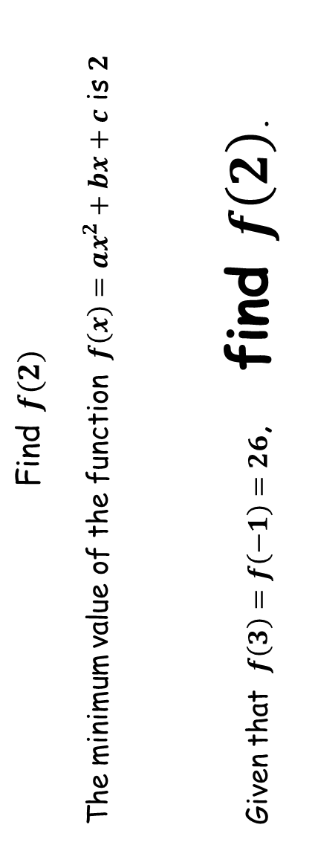
Find $f(2)$
The minimum value of the function $f\left(x\right)=ax^{2}+bx+c$ is $6$
Given that $f\left(3\right)=f\left(−1\right)=14$, find $f\left(2\right)$.
Find $f(2)$
The minimum value of the function $f\left(x\right)=ax^{2}+bx+c$ is $2$
Given that $f\left(3\right)=f\left(−1\right)=26$, find $f\left(2\right)$.
SIC_37
SIC_37

Slide 11
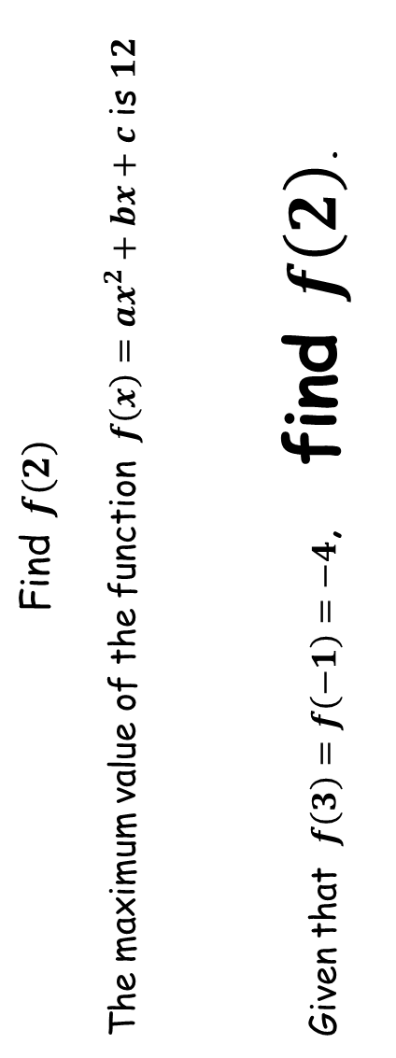
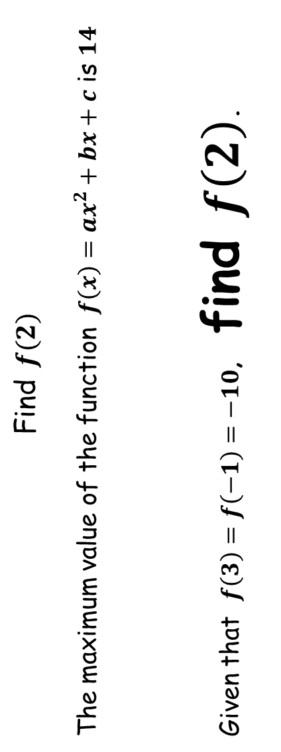
Find $f(2)$
The maximum value of the function $f\left(x\right)=ax^{2}+bx+c$ is $12$
Given that $f\left(3\right)=f\left(−1\right)=−4$, find $f\left(2\right)$.
Find $f(2)$
The maximum value of the function $f\left(x\right)=ax^{2}+bx+c$ is $14$
Given that $f\left(3\right)=f\left(−1\right)=−10$, find $f\left(2\right)$.
SIC_37
SIC_37

Slide 12
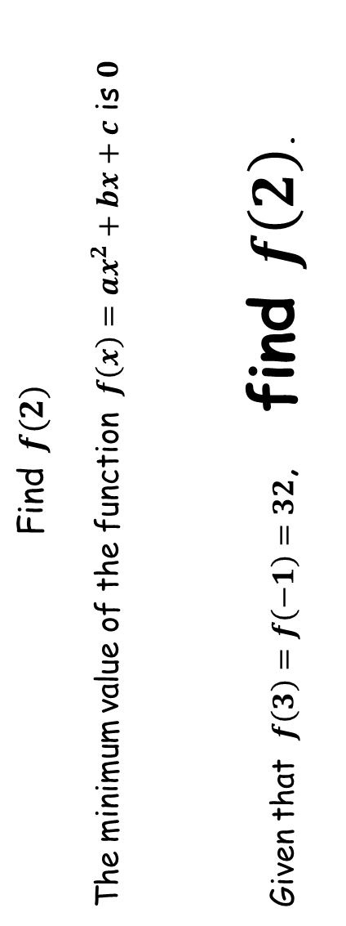
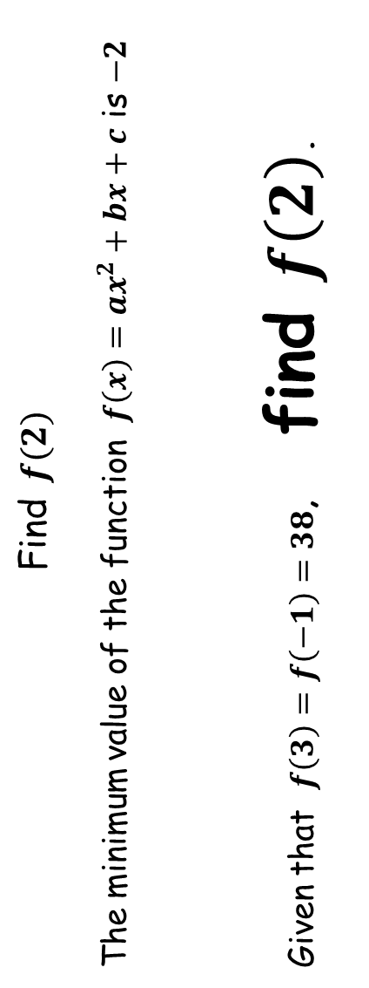
Find $f(2)$
The minimum value of the function $f\left(x\right)=ax^{2}+bx+c$ is $0$
Given that $f\left(3\right)=f\left(−1\right)=32$, find $f\left(2\right)$.
Find $f(2)$
The minimum value of the function $f\left(x\right)=ax^{2}+bx+c$ is $−2$
Given that $f\left(3\right)=f\left(−1\right)=38$, find $f\left(2\right)$.
SIC_37
SIC_37

Slide 13
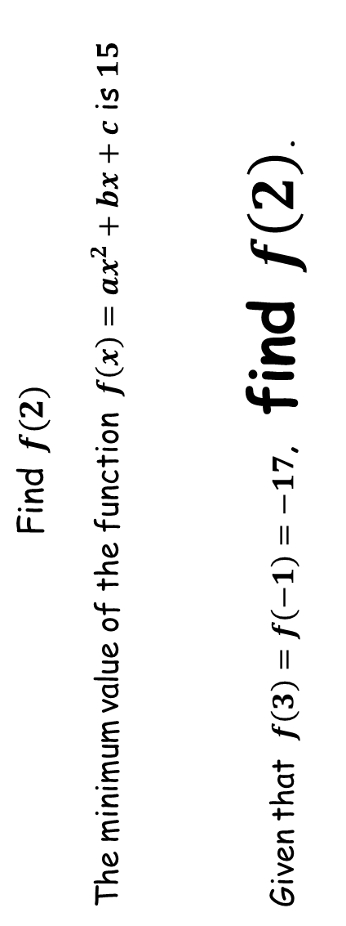
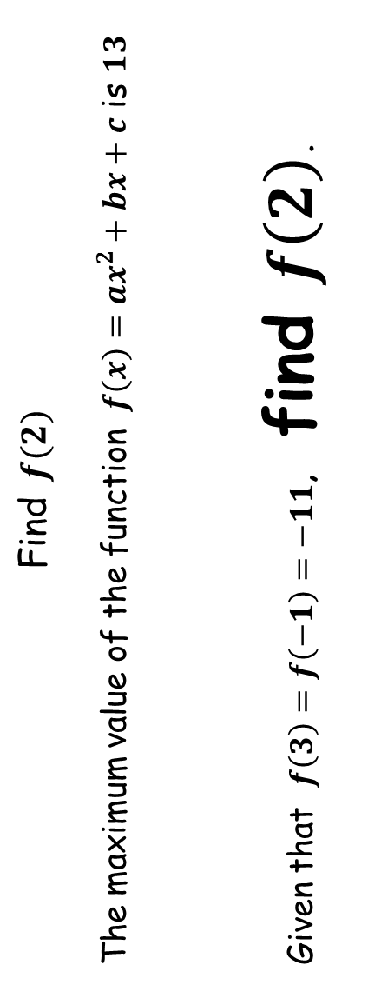
Find $f(2)$
The minimum value of the function $f\left(x\right)=ax^{2}+bx+c$ is $15$
Given that $f\left(3\right)=f\left(−1\right)=−17$, find $f\left(2\right)$.
Find $f(2)$
The maximum value of the function $f\left(x\right)=ax^{2}+bx+c$ is $13$
Given that $f\left(3\right)=f\left(−1\right)=−11$, find $f\left(2\right)$.
SIC_37
SIC_37

Slide 14
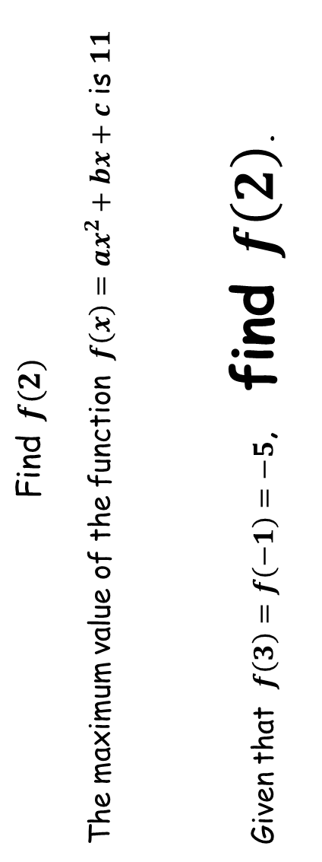
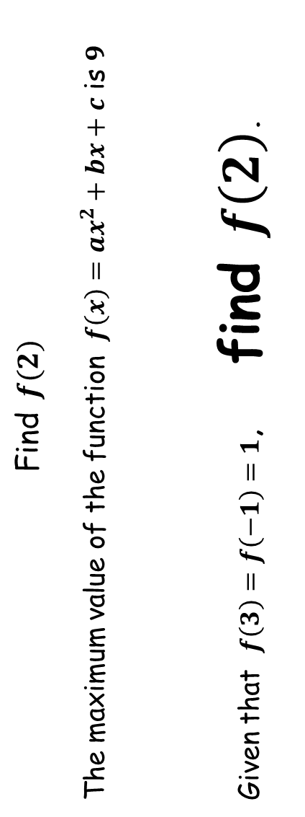
Find $f(2)$
The maximum value of the function $f\left(x\right)=ax^{2}+bx+c$ is $11$
Given that $f\left(3\right)=f\left(−1\right)=−5$, find $f\left(2\right)$.
Find $f(2)$
The maximum value of the function $f\left(x\right)=ax^{2}+bx+c$ is $9$
Given that $f\left(3\right)=f\left(−1\right)=1$, find $f\left(2\right)$.
SIC_37
SIC_37

Slide 15
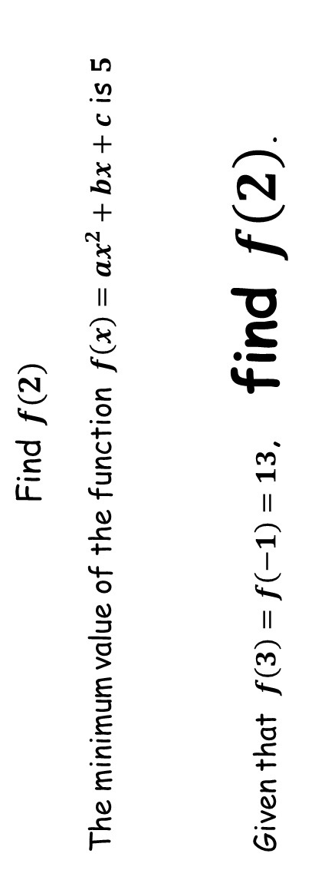
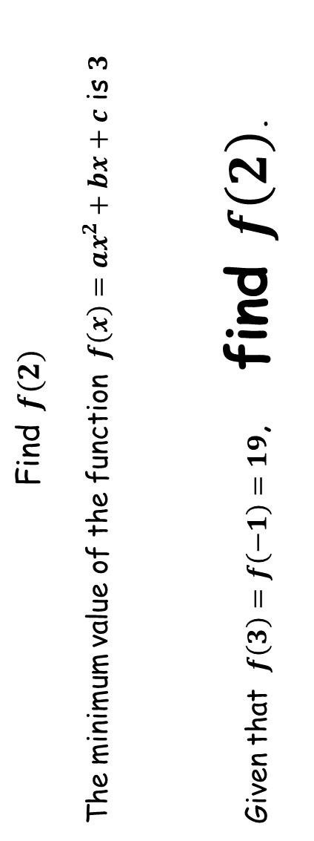
Find $f(2)$
The minimum value of the function $f\left(x\right)=ax^{2}+bx+c$ is $5$
Given that $f\left(3\right)=f\left(−1\right)=13$, find $f\left(2\right)$.
Find $f(2)$
The minimum value of the function $f\left(x\right)=ax^{2}+bx+c$ is $3$
Given that $f\left(3\right)=f\left(−1\right)=19$, find $f\left(2\right)$.
SIC_37
SIC_37

Slide 16
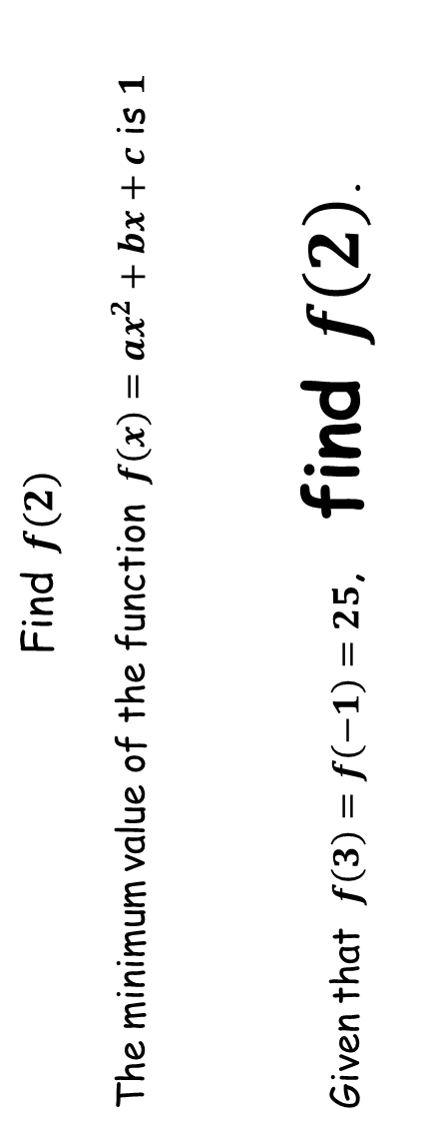
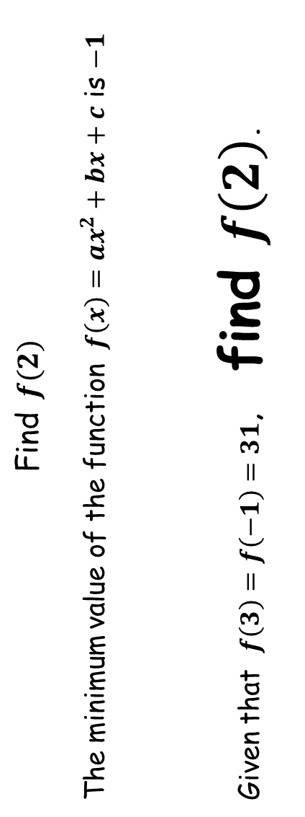
Find $f(2)$
The minimum value of the function $f\left(x\right)=ax^{2}+bx+c$ is $1$
Given that $f\left(3\right)=f\left(−1\right)=25$, find $f\left(2\right)$.
Find $f(2)$
The minimum value of the function $f\left(x\right)=ax^{2}+bx+c$ is $−1$
Given that $f\left(3\right)=f\left(−1\right)=31$, find $f\left(2\right)$.
SIC_37
SIC_37

